Slide 1
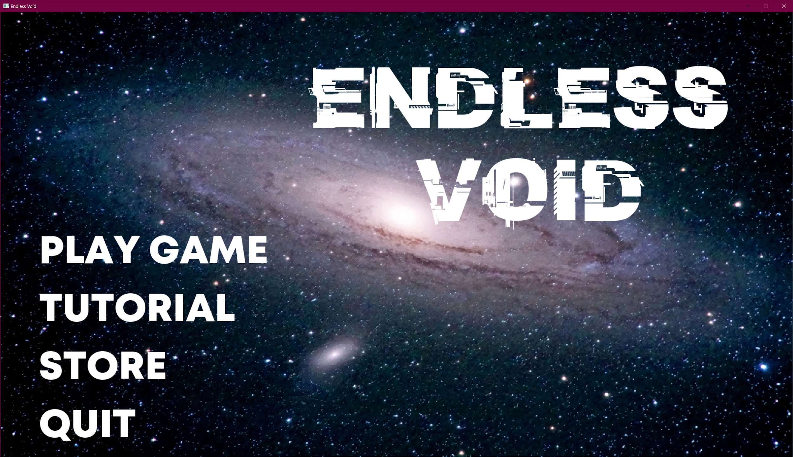
ENDLESS VOID
By Brandon Nguyen, Santosh Lakshman
Eugene Kim, Yi-Wei Lan
For Professor Bentley’s CIS 29 class

Slide 2
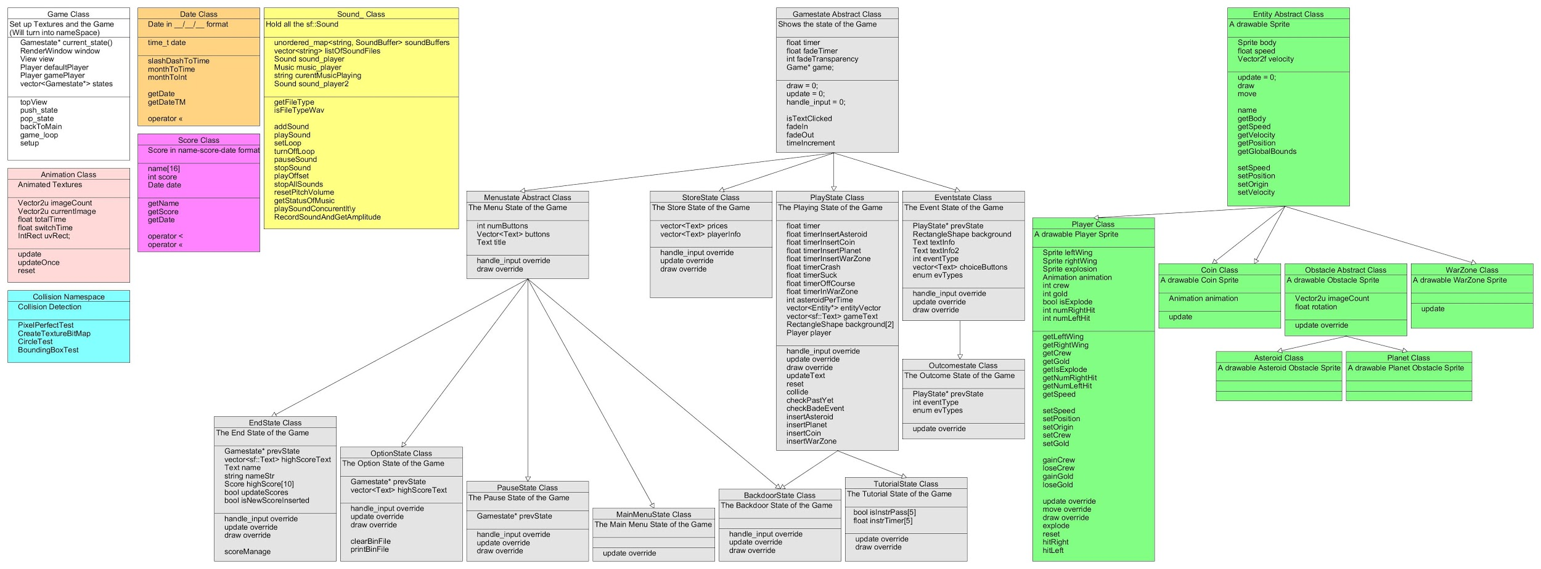
UML

Slide 3
DEMO

Slide 4
Project Requirements

Slide 5
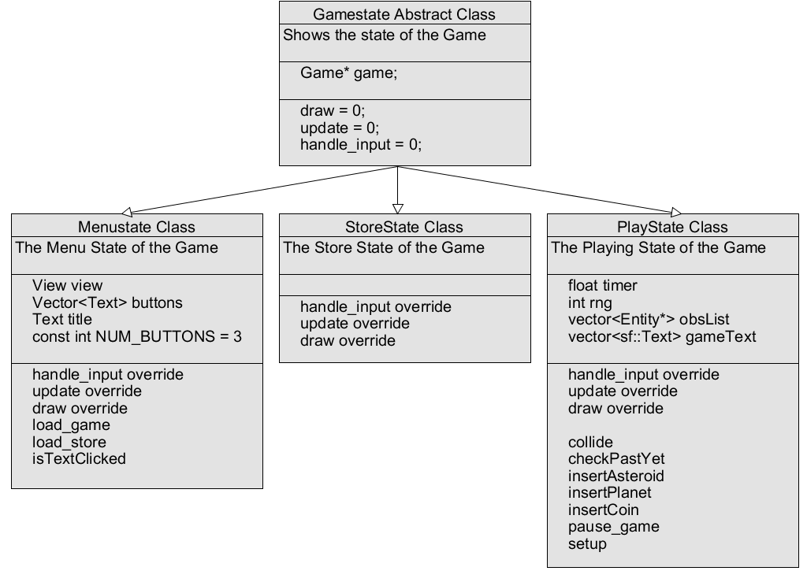
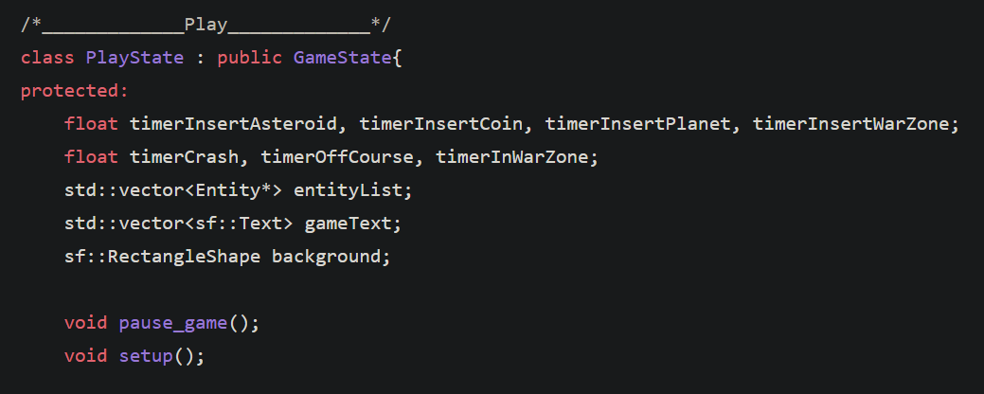
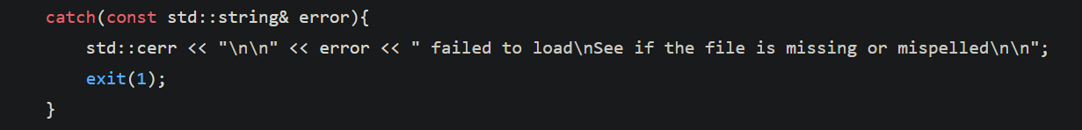
Polymorphism
Exception Handling

Slide 6
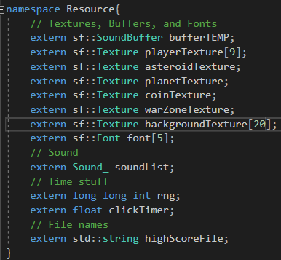
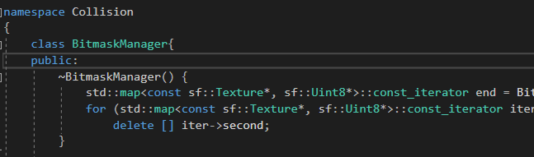
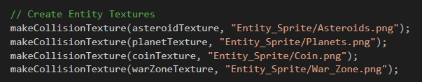
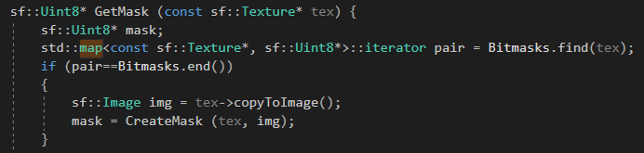
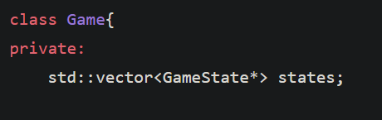
Namespace
STL Containers

Slide 7
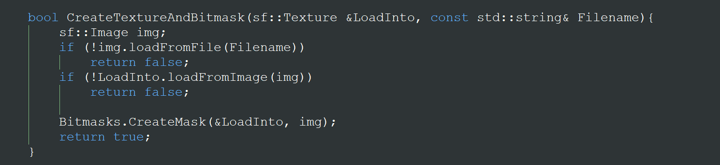
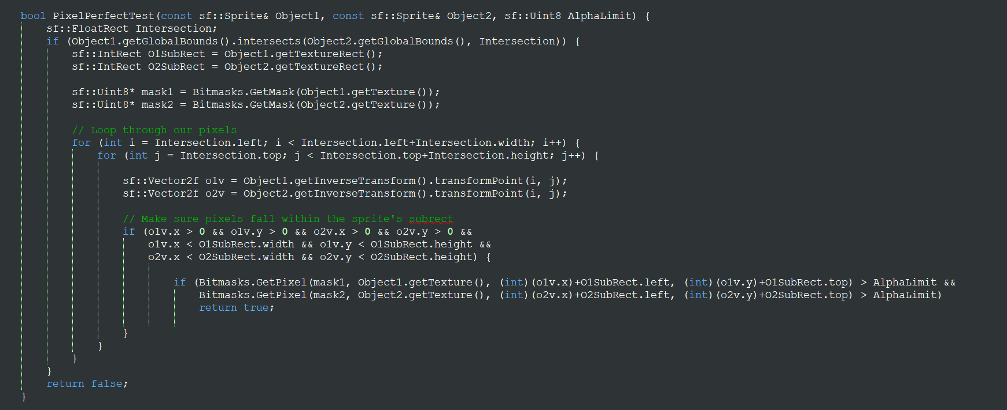
Link: https://github.com/SFML/SFML/wiki/Source:-Simple-Collision-Detection-for-SFML-2
3rd Party code
Collision Detection

Slide 8
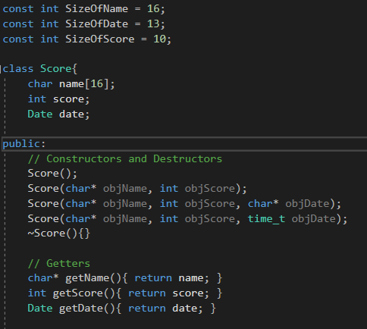
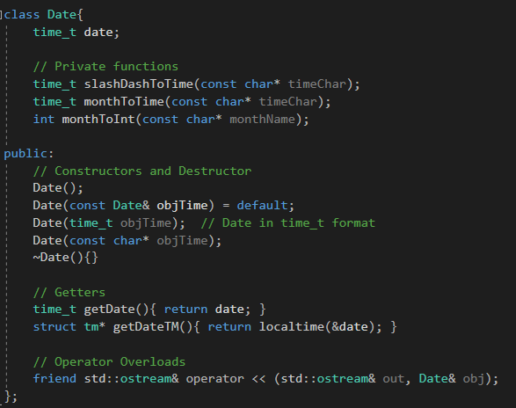


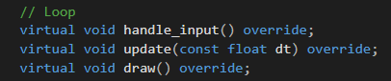


Library
C++ Features
auto keyword
Range-based for loop
default constructor keyword
override keyword
typeid operator
nullptr keyword

Slide 9
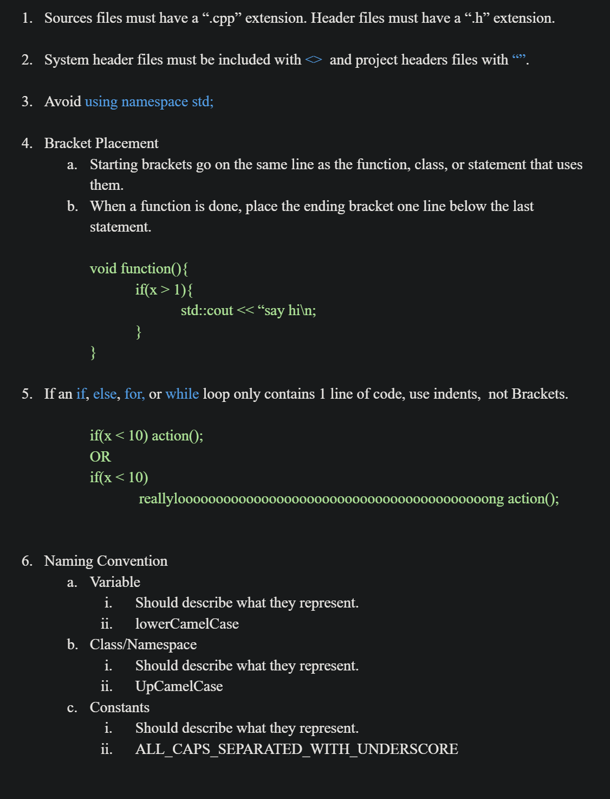
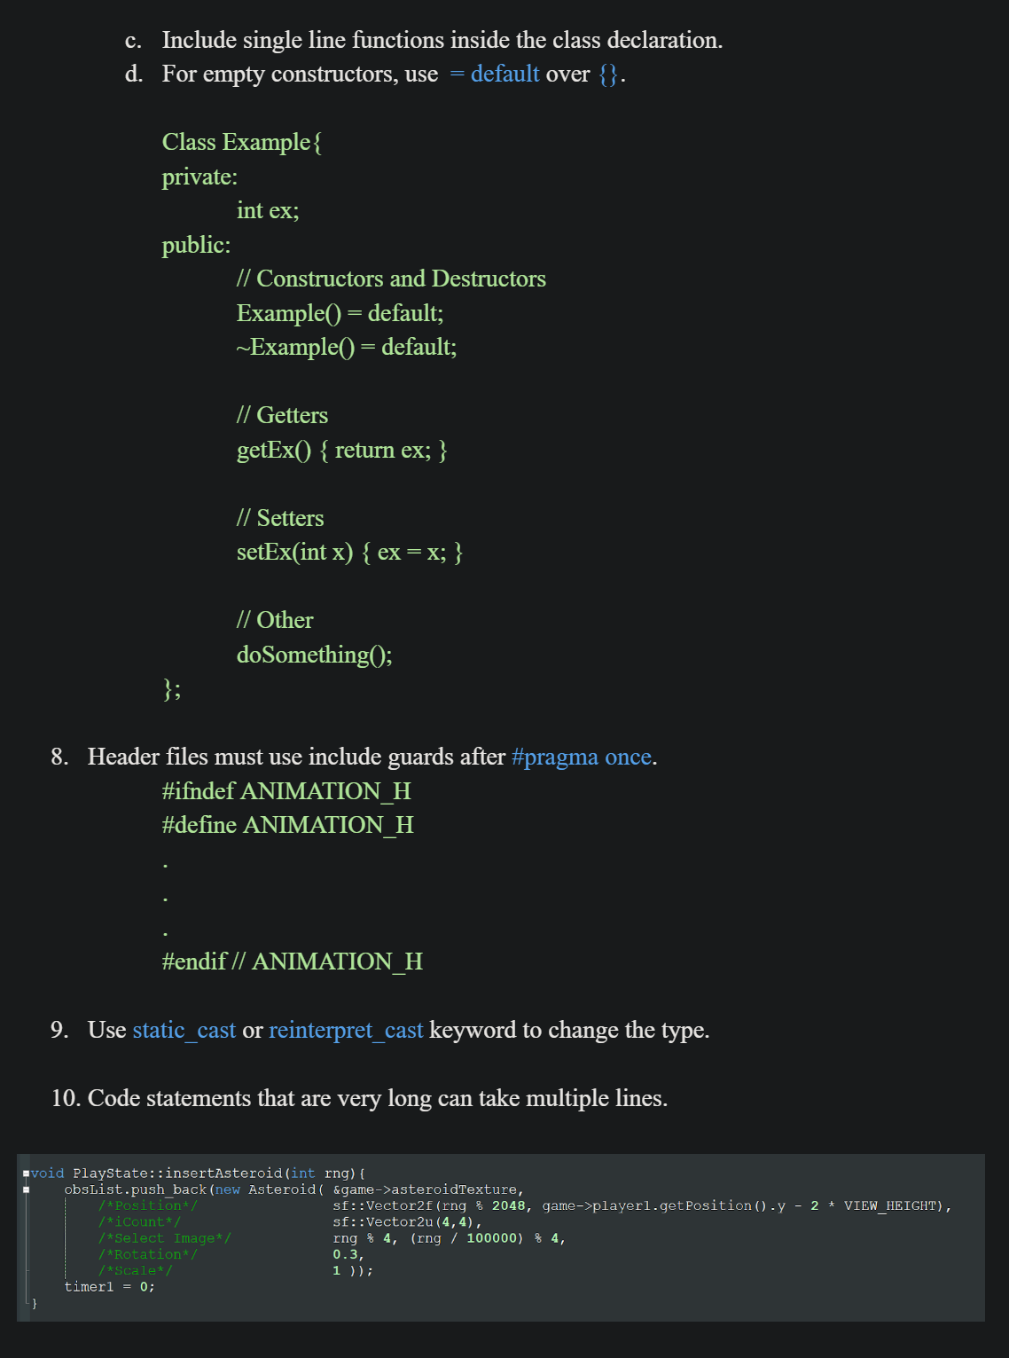
Code Style
Full Code Style

Slide 10
Summary

Slide 11
Things that worked:
Event based progression
Class structure(Gamestates, inheritance)
Things that didn’t:
Different Speeds on different platforms
What are we most proud of:
Atmosphere of the game(music, sprites, writing)
Replayability(Store)
FUN!
Reflections:
Learned a lot
  SFML
  C++
  Git
  much more

Slide 12
Reflections:
Learned a lot
  SFML
  C++
  Git
  much more
For the future
More events
Weapons
More backgrounds/levels

Slide 13
Thank You!

